Slide 1
CARDIOVASCULAR DISEASES
Jonathan

Slide 2
Rheumatic Heart Disease
Also called Rheumatic Endocarditis
Is an acute, recurrent inflammatory disease that causes damage to the heart particularly the valves as a sequelae to group A beta-hemolytic streptococcal infection resulting in valve leakage (insufficiency) and/or obstruction (narrowing or stenosis).
There are associated compensatory changes in the size of the heart's chambers and the thickness of chamber walls in response to the disease

Slide 3
Pathophysiology
Rheumatic fever is a sequelae to group A streptococcal pharyngitis
Heart damage and the joint lesions of rheumatic endocarditis are not infectious in the sense that these tissues are not invaded and directly damaged by destructive organisms rather, they represent a sensitivity phenomenon or reaction occurring in response to hemolytic streptococci.

Slide 4
Leukocytes accumulate in the affected tissues and form nodules, which eventually are replaced by scar tissue.
Heart valves are affected, resulting in valve leakage (regurgitation) and narrowing (stenosis)
Compensatory changes lead to changes in chamber sizes and wall thickness
Heart involvement (carditis) also includes pericarditis, myocarditis, and endocarditis
Rheumatic endocarditis is much more severe and symptomatic than pericarditis and myocarditis

Slide 5
Clinical Manifestations
Symptoms of streptococcal pharyngitis may precede rheumatic symptoms
Sudden onset of sore throat; throat reddened with exudate
Swollen, tender lymph nodes at angle of jaw
Headache and fever(38.9°C - 40° C)
Abdominal pain (children)
Some cases of streptococcal throat infection are relatively asymptomatic
Warm and swollen joints (polyarthritis)
Chorea (irregular, jerky, involuntary, unpredictable muscular movements)

Slide 6
Clinical manifestations-Cont’d
Erythema marginatum (transient mesh-like macular rash on trunk and extremities in about 10% of patients)
Subcutaneous nodules (hard, painless nodules over extensor surfaces of extremities; rare)
Fever
Prolonged PR interval demonstrated by ECG
Heart murmurs; pleural and pericardial friction rubs

Slide 7
Diagnosis
Throat culture - to determine presence of streptococcal organisms
ESR, WBC count and differential, and CRP increased during acute phase of infection
Elevated antistreptolysin-O (ASO) titer
ECG-prolonged PR interval or heart block

Slide 8
Management
Rest-to maintain optimal cardiac function
Salicylates or NSAIDs - to control fever and pain
Corticosteroids - administered to prevent cardiac damage and to treat arthritis and other inflammatory symptoms
Antimicrobial therapy - penicillin is the drug of choice if streptococcal infection is still present
Prevention of recurrent episodes through:
Long-term penicillin therapy for 5 years after initial attack in most adults
Periodic prophylaxis throughout life if valvular damage is present

Slide 9
Complications
Valvular heart disease
Cardiomyopathy
Heart failure

Slide 10
Congestive Cardiac Failure
Is a clinical condition characterized by laboured breathing because the heart fails to meet circulatory and metabolic oxygen demand of the body
Almost all predisposed children develop this problem by the end of 6 months if treatment is not initiated

Slide 11
Causes
Volume overload - from left to right shunts where the right ventricle hypertrophies in order to compensate the increased blood volume e.g. in congenital heart defects
Pressure overload - due to obstructive lesions e.g. valvular stenosis, coarctation of the aorta
Reduced myocardial contractility by severe anemia or asphyxia
High cardiac output demands e.g in sepsis, hormonal problems such as hypothyrodism
Cor pulmonale – which is caused by chronic obstructive lung diseases e.g. cystic fibrosis,

Slide 12
Clinical Manifestations
Left-Sided Heart Failure
Congestion occurs mainly in the lungs from blood backing up into pulmonary veins and capillaries.
Shortness of breath, dyspnea on exertion, paroxysmal nocturnal dyspnea (due to reabsorption of dependent edema that has developed during day), pulmonary edema (manifested by rales, rhonchi, wheezes, and orthopnea)
Cough may be dry, unproductive; usually occurs at night
Signs and symptoms of pulmonary edema, e.g.
Fatigability from low Cardiac Output, nocturia, insomnia, dyspnea, catabolic effect of chronic failure.
Insomnia, restlessness.
Tachycardia, third heart sound
Finger clubbing

Slide 13
Right-Sided Heart Failure
Signs and symptoms are due to elevated pressures and congestion in systemic veins and capillaries:
Edema of ankles →unexplained weight gain (pitting edema)
Liver congestion→hepatomegally - may produce upper abdominal pain
Distended jugular veins
Abnormal fluid in body cavities (pleural space, abdominal cavity)
Anorexia and nausea - from hepatic and visceral engorgement
Nocturia - diuresis occurs at night with rest and improved CO
Weakness

Slide 14
Signs occurring in both Right and Left-sided failure
Cardiomegaly (enlargement of the heart) - detected by physical examination and chest X-ray
Rapid heart rate
Development of pulsus alternans (alternation in strength of beat)

Slide 15
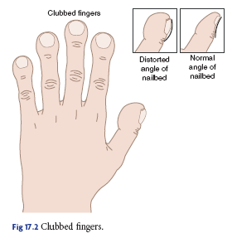

Slide 16
Diagnostic investigations
Echocardiography
Electrocardiography
Chest X-ray - may show cardiomegaly, pleural effusion, and vascular congestion
Arterial Blood Gases(ABG) studies
Liver function tests- altered because of hepatic congestion

Slide 17
Management
The goal is to improve cardiac function
Medications used
Cardiac glycosides – digoxin
Angiotensin converting enzyme (ACE) inhibitors – Captopril
Diuretics e.g. furosemide (lasix)
General care
Restrict and salt intake
Decrease cardiac demands-minimal activity, maintaining normal body temperature
Reduce breathing effort by keeping patient in semi-prone position or high Fowler’s position by proping up the patient’s bed
Avoid environmental stimuli
Improve tissue perfusion by providing supplemental oxygen
Daily weighing
Nutritional support
Alleviating anxiety to both patient and family
Advice on importance of keeping appointment schedules, medication adherence

Slide 18
Congenital Heart Problems
The heart develops very early in the fetal period.
Initially, it is a single tube through which single cells pass.
Rapidly, two sets of chambers form—atria and ventricles.
By the end of the 8th week of fetal development, the atrial and ventricular septa have formed and the pulmonary artery, aorta, and vena cava are all in place.
Unfortunately, many different cardiac defects can develop within the first 8 weeks of pregnancy because many women remain unaware that they are pregnant through this period and may take medications, drink alcohol, or even develop an infectious disease, all of which can cause defects.
The most common heart defect seen in neonates is the ventricular septal defect.

Slide 19
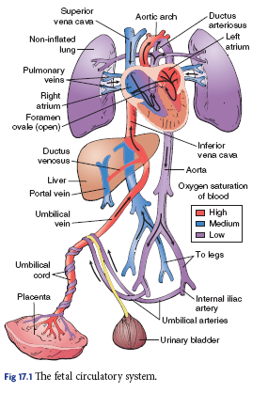
Fetal Circulatory system

Slide 20
Cardiac defects are seen in 4 to 10 out of every 1,000 live births
Etiology.
The cause of majority of defects is unknown but may include:
Prenatal rubella infection
Maternal alcohol consumption
Advanced maternal age
Maternal diabetes
Genetic diseases e.g. Down’s syndrome, Klinefelter’s syndrome, and Turner’s syndrome

Slide 21
Diagnosis of CHDs
Echocardiogram - ultrasound of the heart that is performed to assess the structures of the heart and the blood flow through the heart
Cardiac catheterization - An invasive diagnostic procedure during which a radiopaque catheter is threaded through a peripheral vessel to the heart

Slide 22
Types of Congenital Heart Defects
Acyanotic Defects
Characterized by defects that result in blood being shunted from the left to the right side of the heart. As a result, the blood enters and re-enters the pulmonary system
Atrial septal defect (ASD)
Hole between the atria
May be a foramen ovale that has not closed or a defect unrelated to the fetal duct
S & S - Most have no symptoms, but the child may develop CHF, if the ASD is large. A murmur may be present
Mx - Many ASDs close spontaneously. If not, surgery or interventional cardiology may be performed

Slide 23
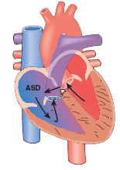

Slide 24
Ventricular septal defect (VSD)
A hole between the ventricles; the most common cardiac defect.
S & S - Most have no symptoms, but the child may develop CHF if the VSD is large. A murmur may be present.
Mx - Small VSDs close spontaneously. If not, surgical repair will be needed

Slide 25
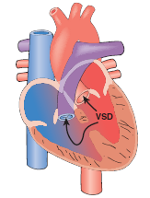

Slide 26
Patent ductus arteriosus (PDA)
Most commonly seen in premature infants, especially when they weigh less ≤ 1,500 g at birth.
The fetal duct between the pulmonary artery and the aorta fails to close.
S & S - May have no symptoms, but a murmur may be heard, and the child may develop CHF.
Mx - The defect may close spontaneously. If not, it may be closed medically with the administration of indomethacin, a prostaglandin inhibitor. If the medication is unsuccessful, surgery may be needed.

Slide 27
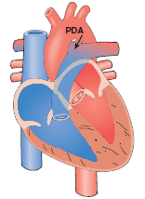

Slide 28
Atrioventricular canal (AVC)
A large hole in the middle of the heart.
S & S - progressively worsening CHF.
Mx - Surgical repair is required.

Slide 29
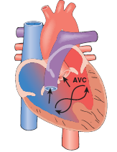

Slide 30
Cyanotic Defects
Some result in the blood being shunted from the right to the left side of the heart.
As a result, the blood bypasses the pulmonary system. In other cyanotic defects, deoxygenated blood never reaches the pulmonary system.
Transposition of the great vessels (TGV)
The aorta exits off the right ventricle and the pulmonary artery off the left ventricle.
This defect is incompatible with life unless another defect is present that allows the mixing of blood.

Slide 31
S & S - Rapid and sustained cyanosis
Mx - Surgery to create an intact vascular system

Slide 32
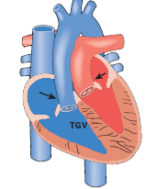

Slide 33
Tetralogy of Fallot (ToF)
Is the most common cyanotic defect, consisting of four defects:
VSD
Overriding aorta
Pulmonary stenosis
Right ventricular hypertrophy.
The right ventricular hypertrophy develops over time because the ventricle is working extra hard to circulate the blood.

Slide 34
S & S- TET spells, in which the child becomes cyanotic, especially when crying and while eating (infancy) and during play (in older children)
Other S & S – polycythemia(↑ RBC count) and clubbing of the fingers.
These signs develop as a result of chronic hypoxic.

Slide 35
Mx
Surgical repair – if the definitive treatment
Supportive management
The cyanosis that develops during a TET spell can be relieved when the legs and knees are bent, resulting in reduced blood flow to the lower body and improved blood flow to the vital organs.
Infants should be placed in a knee-chest position. If the defect has not been repaired, older children usually squat instinctively.

Slide 36
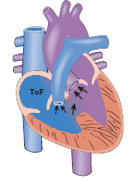

Slide 37
Obstructive Defects
These are characterized by an intact vascular system but with an obstruction preventing the free flow of blood through the heart
Tricuspid atresia (TA)
Is characterized by a closed tricuspid valve, resulting in no movement of blood from the right atrium to the right ventricle.
This defect is incompatible with life unless another defect is present that allows mixing of the blood.
S & S - Rapid and sustained cyanosis.
Mx - Surgical repair

Slide 38
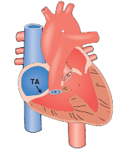

Slide 39
Pulmonic stenosis (PVS)
Is a narrowing of the pulmonary artery or valve.
S & S - Cyanosis during times of activity to severe CHF.
Mx - Balloon angioplasty or surgical repair.

Slide 40
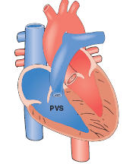

Slide 41
Aortic stenosis (AS)
Is a narrowing of the aorta or aortic valve.
S & S - Murmur to CHF.
Mx - Balloon angioplasty or surgical repair.

Slide 42
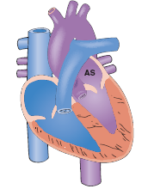

Slide 43
Coarctation of the aorta (CoA)
A narrowing of the aorta, usually distal to the ascending vessels.
S & S - Higher blood pressures and pulses in the upper extremities as compared to those in the lower extremities.
If left uncorrected, older children suffer from recurrent episodes of epistaxis and complaints of leg cramps or leg pain, especially during periods of activity.
Mx - Surgical repair.

Slide 44
